Slide 1


Workplace of the future
NATHALIE VON HUTH:
nathalie.huth.14@ucl.ac.uk
LAMAN MAMMADOVA:
laman.mammadova.14@ucl.ac.uk
Notes:
Laman

Slide 2


Connect with your co-workers…
Notes:
Remote workers
Tali

Slide 3

Problem
Remote
Less social
Team Work
Notes:
Build whatever we wanted
Competitors
Laman

Slide 4


Key Requirements
Login
Create Team
News feed
Messaging
TeaRoom
User Page
Mood status
Sharing location
Sharing status
Notes:
Laman

Slide 5
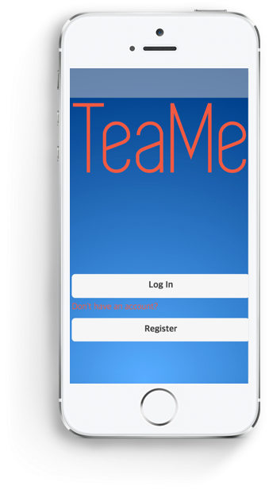
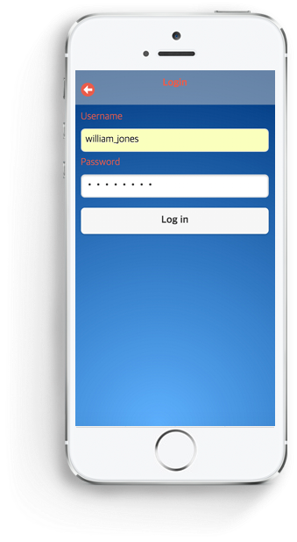
Login
Notes:
Explain why login is important to protect the user information
Nathalie

Slide 6
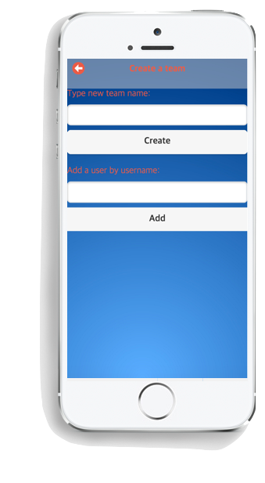
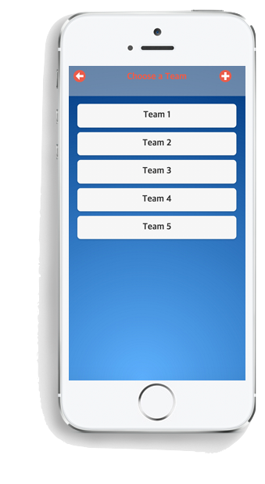
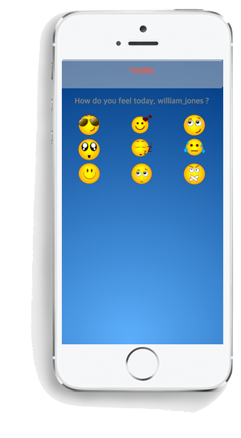
Teams & Feelings
Notes:
Explain why login is important to protect the user information
Nathalie

Slide 7
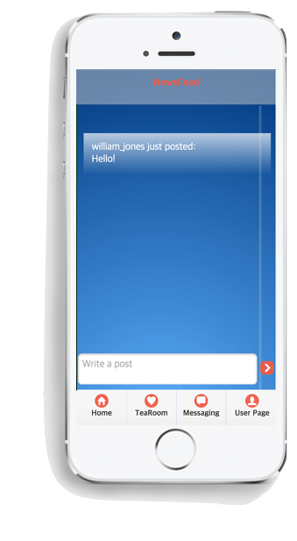
Newsfeed
Notes:
Explain why login is important to protect the user information
Nathalie

Slide 8
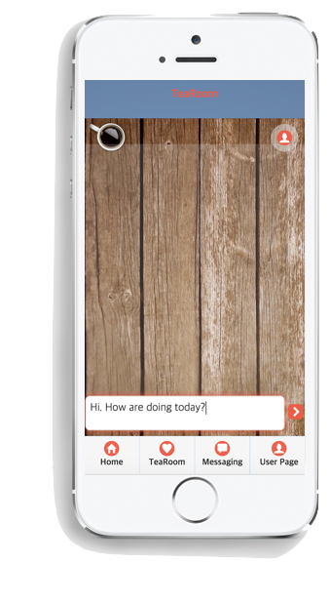
TeaRoom
Notes:
Explain why login is important to protect the user information
Nathalie

Slide 9
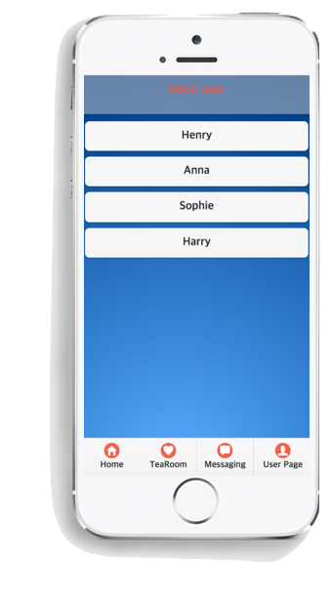
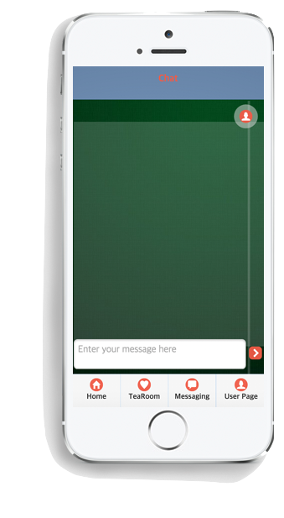
Private Chat
Notes:
Since all very similar, they are using the same technology
Nathalie

Slide 10
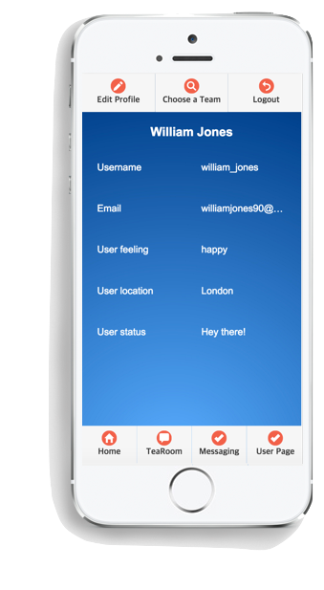
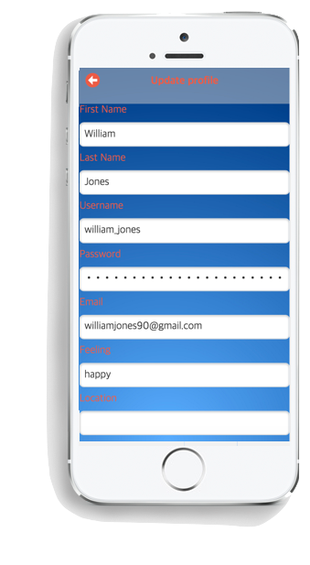
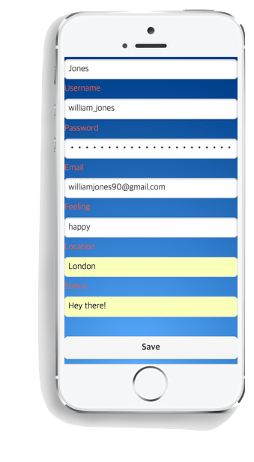
User Page
Notes:
Since all very similar, they are using the same technology
Nathalie

Slide 11






Development– Front end
Notes:
Nathalie

Slide 12





Development– Back end
Notes:
Laman

Slide 13
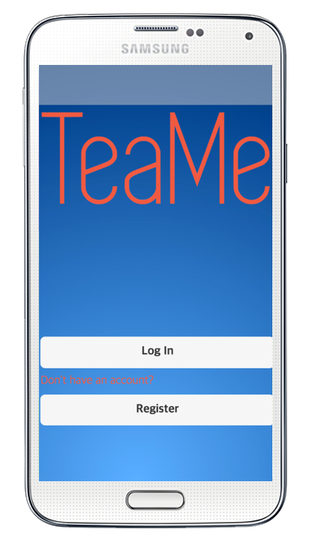

Converting to mobile app
+
Notes:
Nathalie

Slide 14
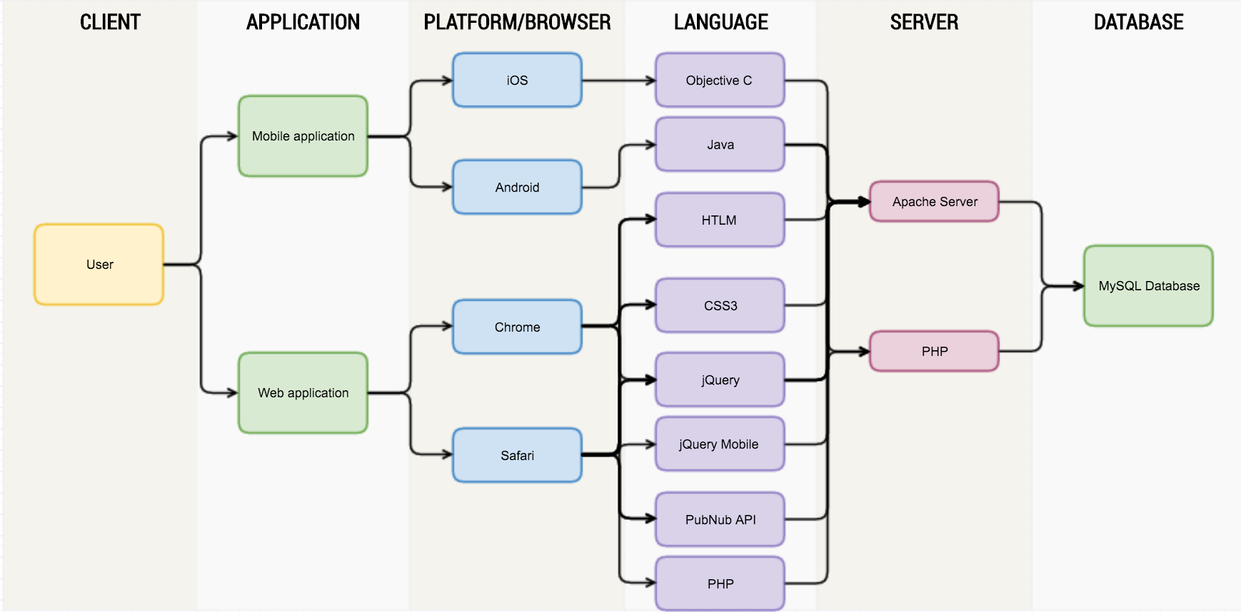
Architecture Flow
Notes:
Nathalie

Slide 15

Testing the system
User-acceptance testing
Testing use cases
Finding problems
Fixing errors
Passing test cases
User experience testing
Questionnaires
Feedback
Notes:
Laman

Slide 16
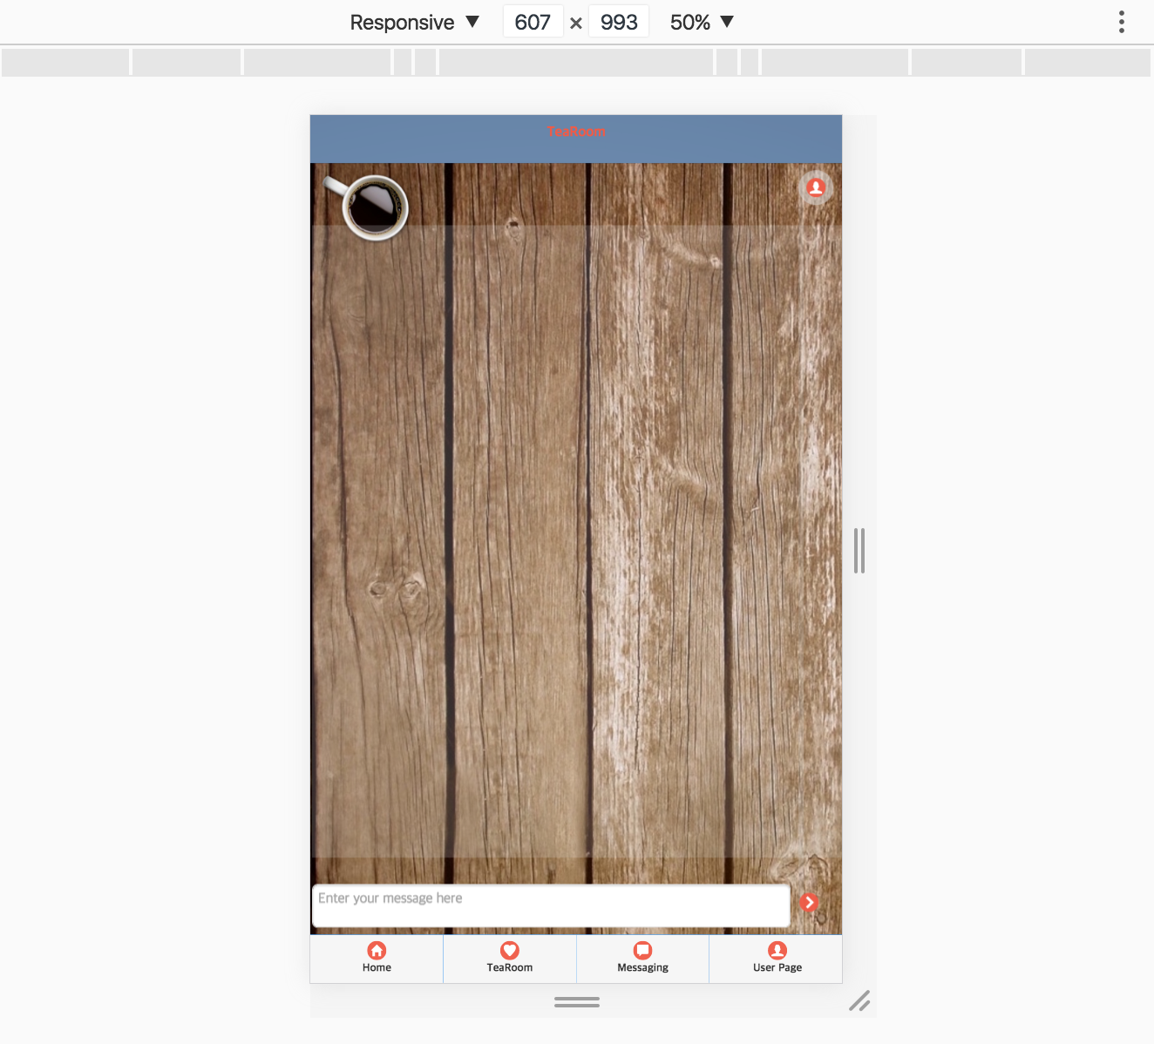
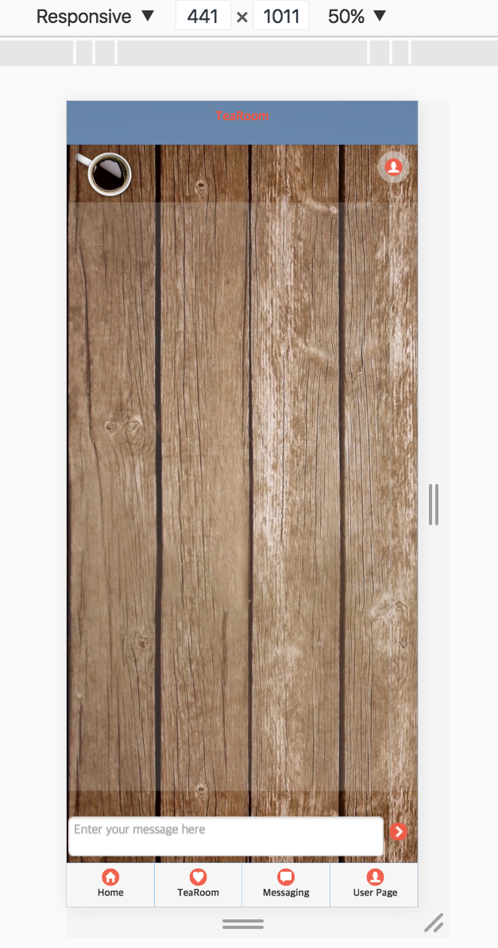
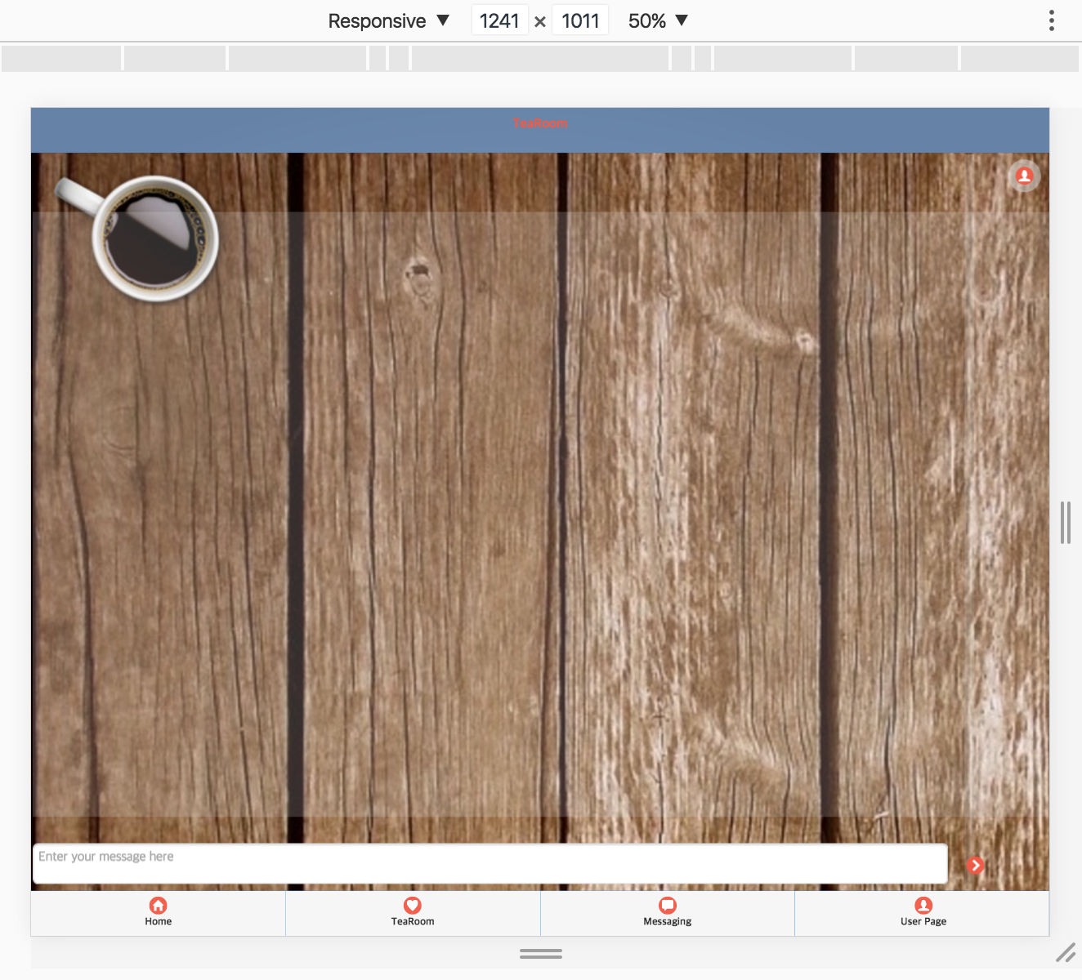
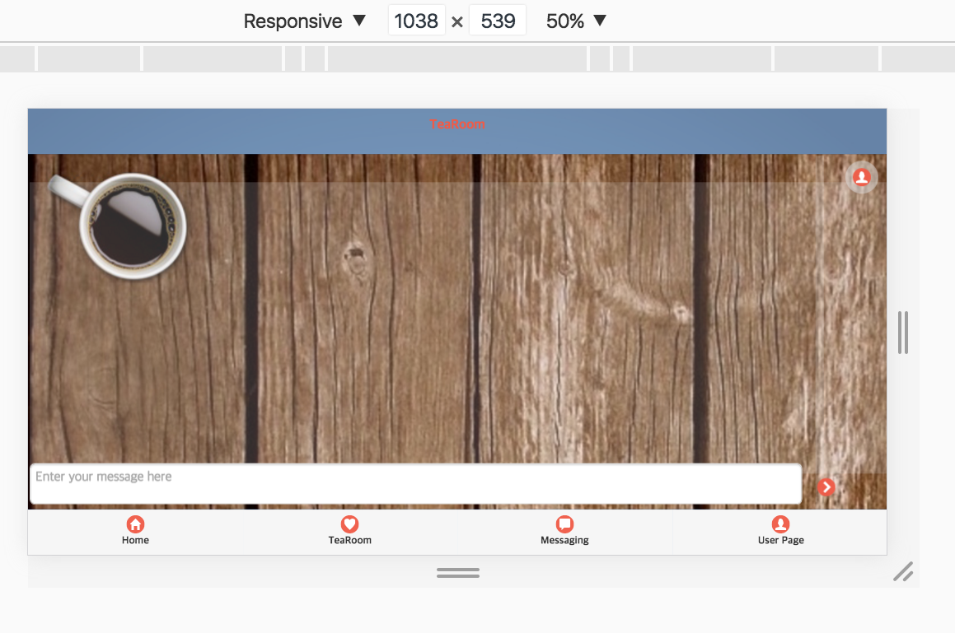
Testing the system
Responsive design testing
Notes:
Laman

Slide 17
Testing the system
Cross platform testing
Notes:
Laman

Slide 18

Evaluation
Successes
Failures
Satisfactory interface
Database management
Responsiveness
Chat
Newsfeed
TeaRoom
Private Chat
Pubnub restrictions
Error messages
Security
Notes:
Laman

Slide 19

Future directions
Improve UI/UX
Make available for production
Facebook login
External server
PubNub – multiple channels
Management system
Notes:
Sending reports to manager
Nathalie

Slide 20
Conclusion & Final Thoughts
Help remote workers
Keep in touch
Life balance
Manage team
Understand others
Notes:
Talk about how it will help remote workers
What’s good about the application
Nathalie

Slide 21
THANK YOU
Q&A
NATHALIE VON HUTH & LAMAN MAMMADOVA
Notes:
Talk about how it will help remote workers
What’s good about the application
Nathalie

